Slide 1
Introduction to Digital Peripherals
Dheeraj Kamath - Applications Engineer
WW 20 17

Slide 2
Objective
By the end of this training, you will
Learn the digital peripherals available in Cypress’ PSoC 6
Understand their basic functions
Learn how to use them in an application using ModusToolbox
Hardware:
PSoC6 BLE Pioneer Kit
PSoC6 WIFI-BT Pioneer Kit
CY8CPROTO-062-4343W PSoC6 Prototyping Kit
Software:
ModusToolbox 2.1

Slide 3
Agenda
Recap
Quick overview: ModusToolbox 2.1
Introduction
Digital Architecture
Smart-IO
TCPWM
SCBs
Exercises

Slide 4
Recap
In the previous training we understood:
what ModusToolbox is
what it comprises
How to create a project
the directory structure
different tools and configurators
terminologies like HAL, BSP, PDL
different ecosystems supported by ModusToolbox
Application
Board Support Package (BSP)
Hardware Abstraction Layer (HAL)
Peripheral Driver Library (PDL)
Hardware

Slide 5

ModusToolbox 2.1
What’s new?
No longer called ModusToolbox IDE
Proxy Handling Improvements
Upgrades to Tools and Configurators
OpenOCD 3.0
Offline Support Package
Support for third party IDEs
IAR Embedded Workbench
Keil ARM-MDK
Visual Studio Code (VSCode)

Slide 6
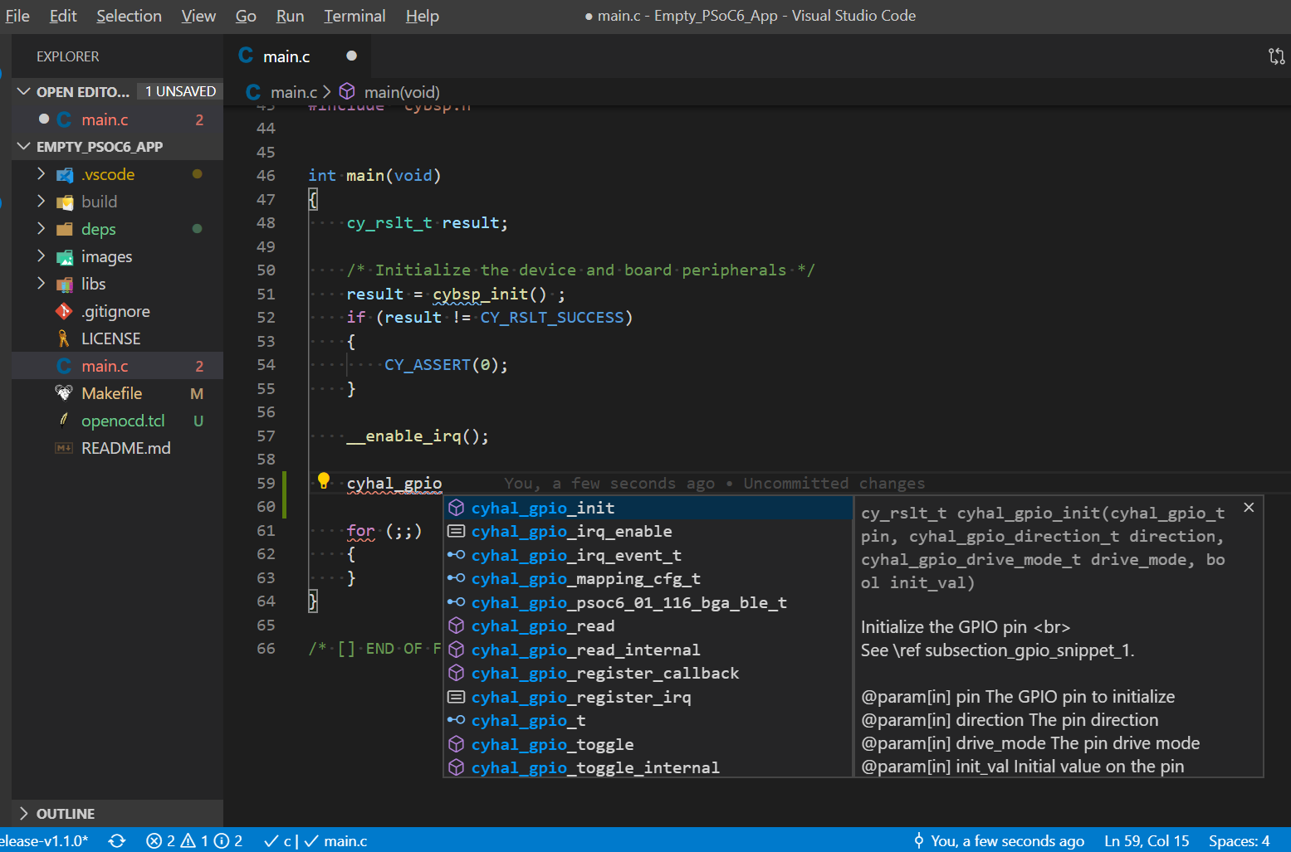
Visual Studio Code
Yes, now you can work in dark mode!!!

Slide 7
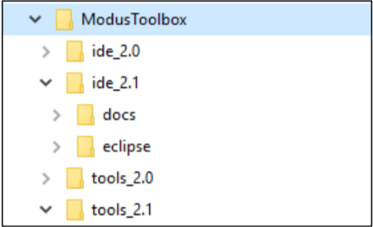
Product Versioning
The ModusToolbox installation package is versioned as MAJOR.MINOR.PATCH. The file located at /ModusToolbox/tools_2.1/version-2.1.0.xml also indicates the build number
Multiple versions installed in parallel in the same ModusToolbox directory
Flexibility to use the version you want
Using Application Makefile
Set CY_TOOLS_PATH in environment variable

Slide 8
Introduction

Slide 9
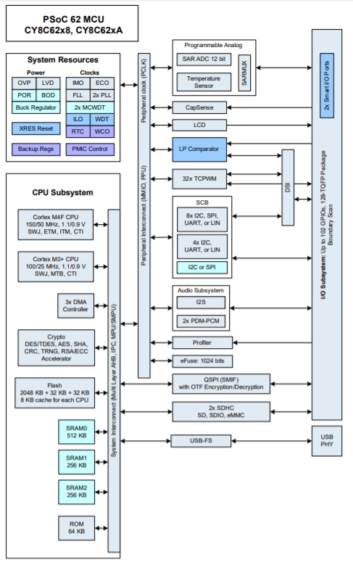
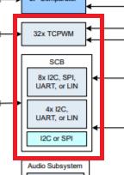
PSoC6 Device Architecture

Slide 10
PSoC6 Digital Peripherals
Programmable Digital
Smart-IO - programmable logic fabric that enables Boolean operations on signals passing through it
Fixed-Function Digital
Timer/Counter/PWM Block (TCPWM) –
Timer-counter with compare
Timer-counter with capture
Quadrature decoding
Pulse width modulation (PWM)
Serial Communication Blocks (SCB) – digital block that is configurable as UART, I2C or SPI interfaces
USB, QSPI, SD Host Controller (out of scope for this training)
2 x Smart-IO Ports
32 x TCPWM

Slide 11
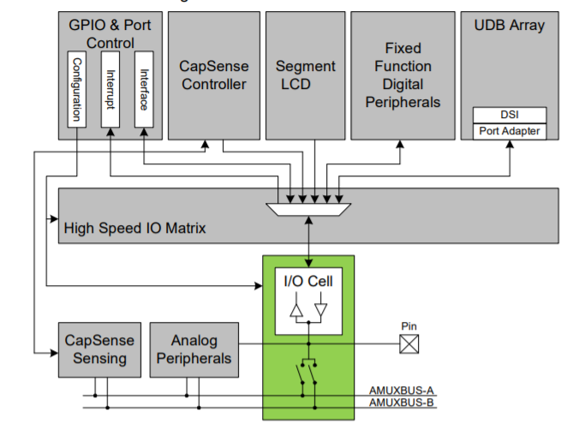
High Speed Input Output Matrix (HSIOM)
Contains multiplexers to connect between the selected peripheral and the pin.

Slide 12
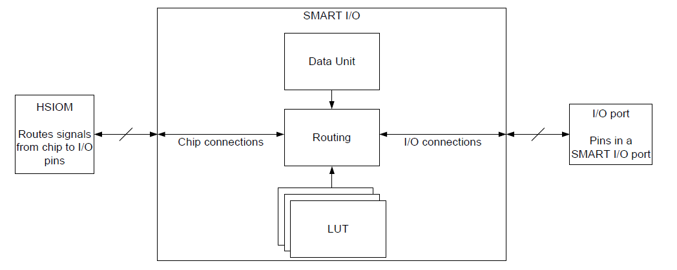
Smart-IO
The Smart I/O block sits between the GPIO pins and the high-speed I/O matrix (HSIOM) and is dedicated to a single port.
Smart I/O supports:
Deep Sleep operation
Boolean operations without CPU intervention
Asynchronous or synchronous (clocked) operation
Three selectable input sources
another LUT
an internal resource
an external signal from a GPIO pin

Slide 13
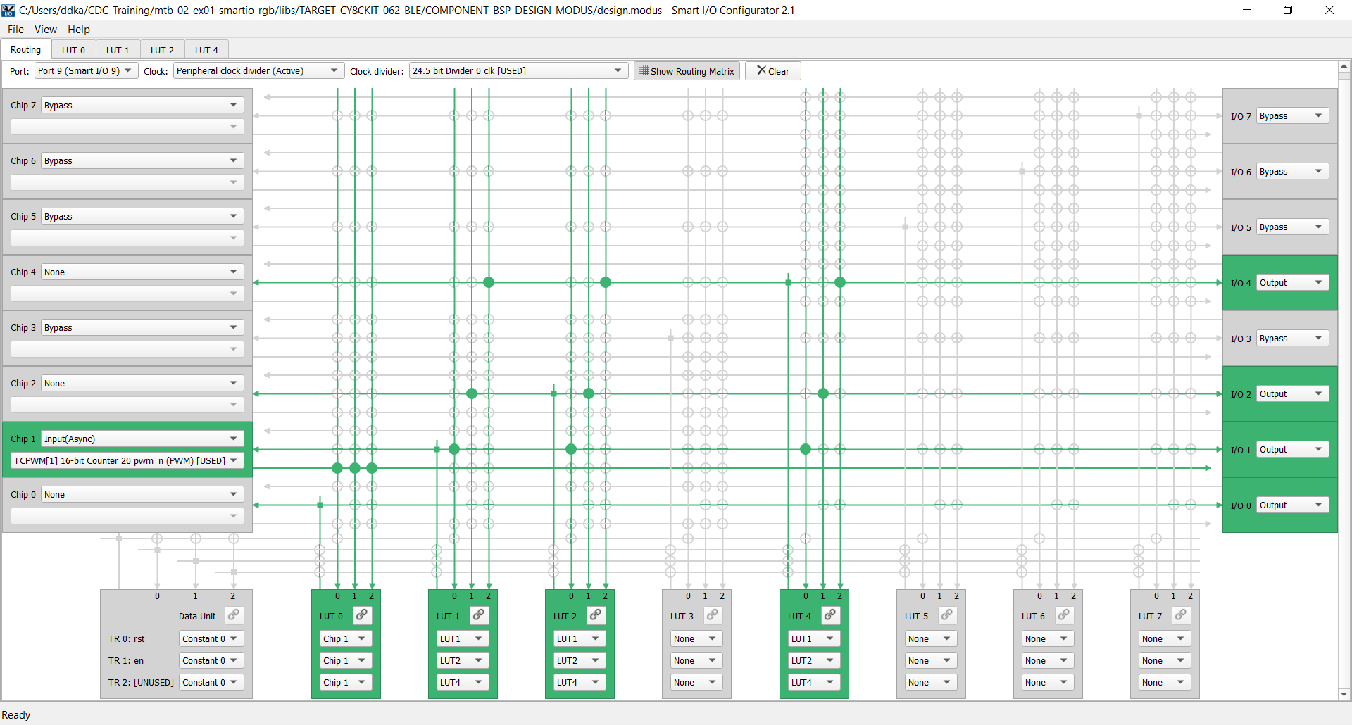
Smart-IO Configurator

Slide 14
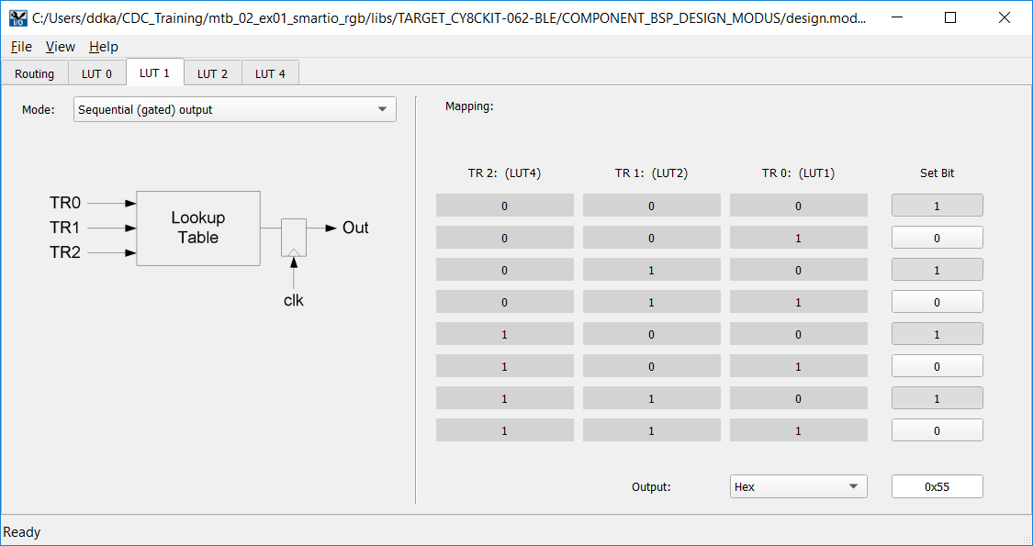
Lookup Table (LUT)

Slide 15
Using Smart-IO in your Application
Steps:
Go to design.modus file and enable Smart-IO. Use the Smart-IO configurator to define the inputs, the outputs and the logical operations to be performed.
Make use of these APIs (basic) to start the Smart-IO block
Cy_SmartIO_Init(SMARTIO_HW, &SMARTIO_config); - Initializes the SMART-IO Block
Cy_SmartIO_Enable(SMARTIO_HW); - Enables it
Refer to the code example ”Ramping LED using Smart-IO” for more information.
Note: No HAL yet, support only through PDL.

Slide 16
Smart-IO Configurator
Exercise 1:
Configure a PWM to generate a frequency of 1Hz with 50% duty cycle. Route this signal to pin 9[0] using the Smart-IO Block. In firmware read the output on pin 9[0] and write to LED9 (P13_7) and observe the LED blinking every second.
Exercise 2:
Create a LUT such that it functions as a 8-bit counter. Route the three output signals of the LUT to the RGB LEDs and observe the colors as shown in the below table.
LUT3 | LUT2 | LUT1 | Color
0 | 0 | 0 | OFF
0 | 0 | 1 | RED
0 | 1 | 0 | GREEN
0 | 1 | 1 | YELLOW
1 | 0 | 0 | BLUE
1 | 0 | 1 | PINK
1 | 1 | 0 | INDIGO
1 | 1 | 1 | WHITE
Refer mtb_02_ex01_smartio_rgb project which implements the solution to both the exercises.

Slide 17
Smart-IO Configurator
Exercise 2 LUT Logic Explained:
Present State |  |  | Next State
LUT4 | LUT2 | LUT1 | LUT4 | LUT2 | LUT1
0 | 0 | 0 | 0 | 0 | 1
0 | 0 | 1 | 0 | 1 | 0
0 | 1 | 0 | 0 | 1 | 1
0 | 1 | 1 | 1 | 0 | 0
1 | 0 | 0 | 1 | 0 | 1
1 | 0 | 1 | 1 | 1 | 0
1 | 1 | 0 | 1 | 1 | 1
1 | 1 | 1 | 0 | 0 | 0
Refer mtb_02_ex01_smartio_rgb project which implements the solution to both the exercises.

Slide 18
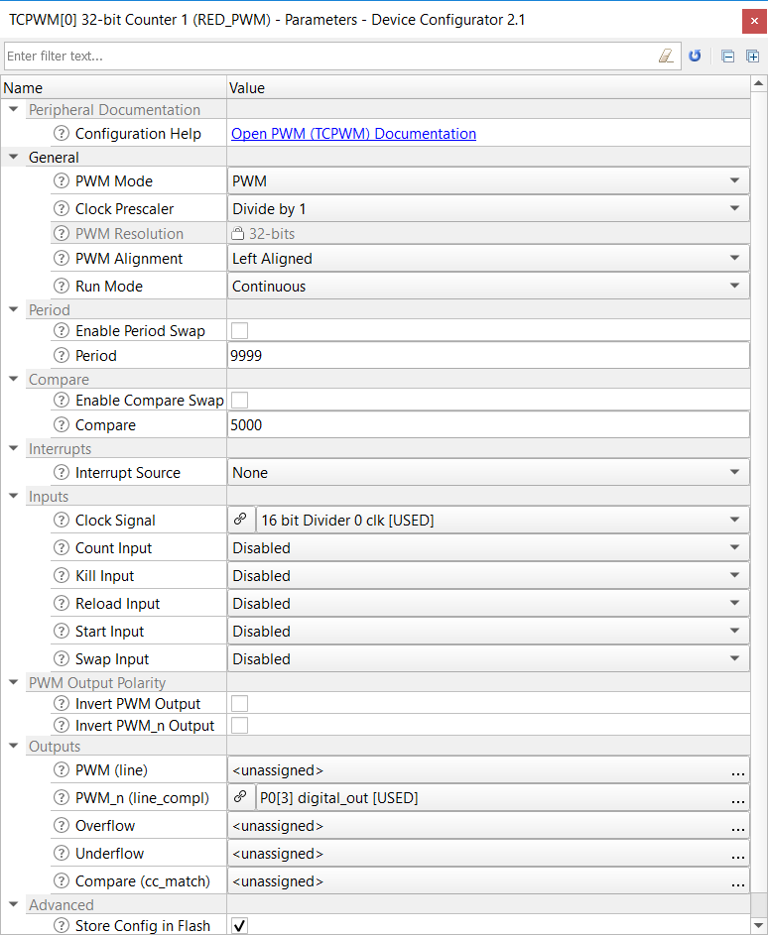
Timer Counter Pulse Width Modulation
Multi-functional, configurable digital block containing 32 counters. Each can be 16 or 32-bit wide.
Modes:
Counter – counts events, for e.g., number of pulse edges
Timer – sets up a counter to generate time intervals
PWM – Generates pulses based on the duty cycle, period and compare values
Up, Down, and Up/Down counting modes
Clock prescaling (division by 1, 2, 4, ... 64, 128)

Slide 19
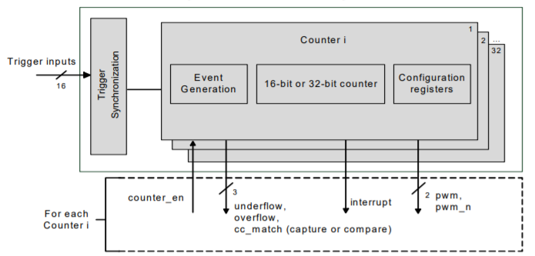
Timer Counter Pulse Width Modulation
Provides two interfaces:
I/O signal interface:
Consists of input triggers:
Reload
Start
Stop
Count
Capture
Output signals:
pwm
pwm_n
overflow (OV)
underflow (UN)
capture/compare (CC)).
Interrupts: Provides interrupt request signals from each counter, based on TC or CC conditions

Slide 20
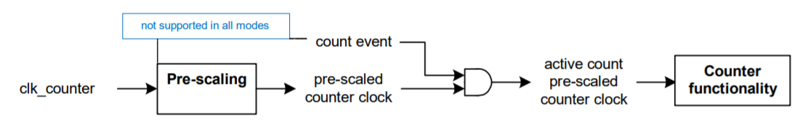
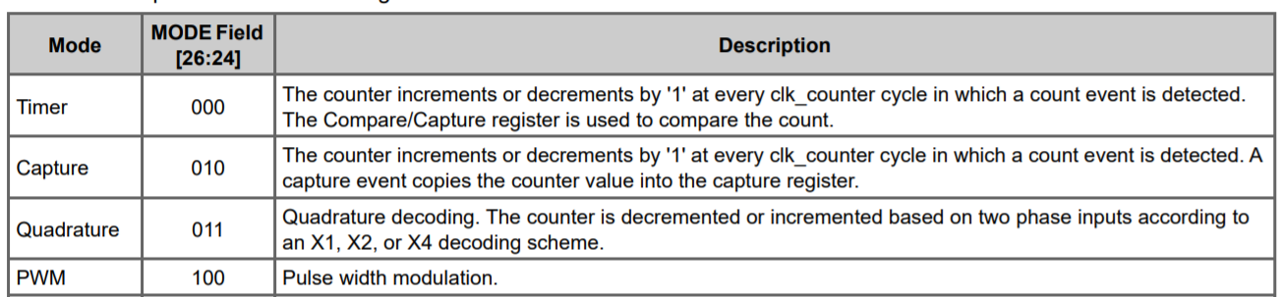
Counter Functionality
Configurable Modes

Slide 21
Understanding HAL
It is a generic interface that can be used across multiple product families
The focus is on ease-of-use and portability
API Structure
_init function – Allocates a block, configures it and enables it.
_free function – Disables a block, releases resources
Other functions – provide block specific functionality

Slide 22
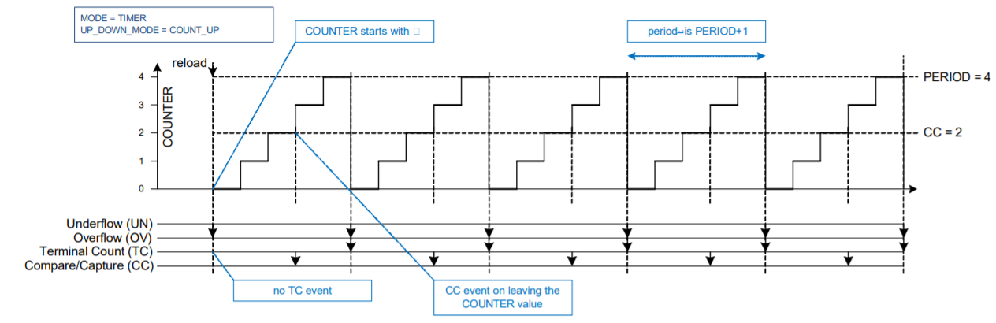
Timer
Increments/decrements a counter between 0 and the value stored in the PERIOD register.
Used for:
Timing a specific delay
Counting the occurrence of a specific event

Slide 23
Using Timer in your Application
Steps:
Using HAL APIs:
First configure the timer parameters using cyhal_timer_cfg_t and then initialize and enable it as shown:
const cyhal_timer_cfg_t led_blink_timer_cfg =
{
.compare_value = 0, /* Timer compare value, not used */
.period = LED_BLINK_TIMER_PERIOD, /* Defines the timer period */
.direction = CYHAL_TIMER_DIR_UP, /* Timer counts up */
.is_compare = false, /* Don't use compare mode */
.is_continuous = true, /* Run timer indefinitely */
.value = 0 /* Initial value of counter */
};
cyhal_timer_init(&led_blink_timer, NC, NULL);
cyhal_timer_configure(&led_blink_timer, &led_blink_timer_cfg);
cyhal_timer_set_frequency(&led_blink_timer, LED_BLINK_TIMER_CLOCK_HZ);

Slide 24
Using Timer in your Application
Additionally you can register the callback functions to be triggered when a specific event occurs using the following APIs:
/* Assign the ISR to execute on timer interrupt */
cyhal_timer_register_callback(&led_blink_timer, isr_timer, NULL);
/* Set the event on which timer interrupt occurs and enable it */
cyhal_timer_enable_event(&led_blink_timer, CYHAL_TIMER_IRQ_TERMINAL_COUNT,
7, true);
Then you can go ahead and start the timer!
/* Start the timer with the configured settings */
cyhal_timer_start(&led_blink_timer);

Slide 25
Using Timer in your Application
Steps:
Using PDL APIs:
First configure the timer parameters using the design.modus file and then use the following APIs to start the timer:
/* Initialize the interrupt */
Cy_SysInt_Init(&timer_isr_config, timer_isr);
NVIC_EnableIRQ(timer_isr_config.intrSrc);
/* Start the timer */
Cy_TCPWM_Counter_Init(TIMER_HW, TIMER_NUM, &TIMER_config);
Cy_TCPWM_Counter_Enable(TIMER_HW, TIMER_NUM);
Cy_TCPWM_TriggerStart(TIMER_HW, TIMER_MASK);

Slide 26
Counter
The capture functionality increments and decrements a counter between 0 and PERIOD. When the capture event is activated the counter value COUNTER is copied to CC.
Used for:
Measuring the width of a pulse
Measuring the frequency of a signal

Slide 27
Using Counter in your Application
Steps:
Using PDL APIs (HAL not supported):
First configure the timer parameters using the design.modus file and then use the following APIs to start the timer:
/* Start the timer */
Cy_TCPWM_Counter_Init(COUNTER_HW, COUNTER_NUM, &COUNTER_config);
Cy_TCPWM_Counter_Enable(COUNTER_HW, COUNTER_NUM);
Cy_TCPWM_TriggerStart(COUNTER_HW, COUNTER_MASK);
To read the captured values use:
Cy_TCPWM_Counter_GetCapture()

Slide 28
Timer/Counter
Exercise 3:
Configure a timer to generate an interrupt every 1s and toggle the LED. Use only HAL APIs.
Refer mtb_02_ex04_timer_hal project which implements the solution to this exercise.
Exercise 4:
Configure a timer to generate an interrupt every 1s and toggle the LED. Use only PDL APIs.
Refer mtb_02_ex05_timer_pdl project which implements the solution to this exercise. Compare this with the previous exercise. Which do you think was easier?
Exercise 5:
Generate a 250 Hz signal with any duty cycle using PWM
Use a Counter to measure counts between PWM pulses
Print measured frequency to serial terminal using UART
Refer mtb_02_ex06_counter_dutycycle project which implements the solution to this exercise.

Slide 29
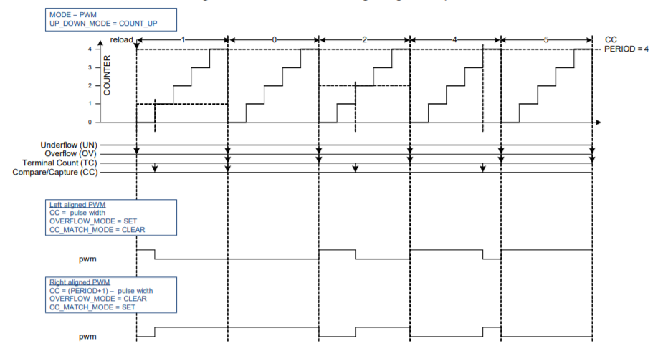
PWM

Slide 30
Using PWM in your Application
Steps:
Using HAL APIs:
Add the following code directly in main.c to interact with the PWM block
cyhal_pwm_init(&pwm_obj, CYBSP_USER_LED, NULL);
cyhal_pwm_set_duty_cycle(&pwm_obj, 50, 1);
cyhal_pwm_start(&pwm_obj);
Using PDL APIs:
Configure a PWM in design.modus file with the required parameters and then call the following APIs:
Cy_TCPWM_PWM_Init(PWM_HW, PWM_NUM, &PWM_config);
Cy_TCPWM_PWM_Enable(PWM_HW, PWM_NUM);
Cy_TCPWM_TriggerStart(PWM_HW, PWM_MASK);

Slide 31
PWM
Exercise 6:
Configure a PWM to generate a frequency of 1Hz with 50% duty cycle using HAL and PDL APIs. Check if there is a conflict.
Solution key: Refer mtb_02_ex02_pwm_blinkyled project for this solution.
Exercise 7:
Configure a PWM to increase the brightness of the LED to its maximum and then decrement to its lowest. Hint: Vary the duty cycle every 500ms to observe the output on the LED.
Solution key: Refer mtb_02_ex03_pwm_brightness_control project for this solution.

Slide 32
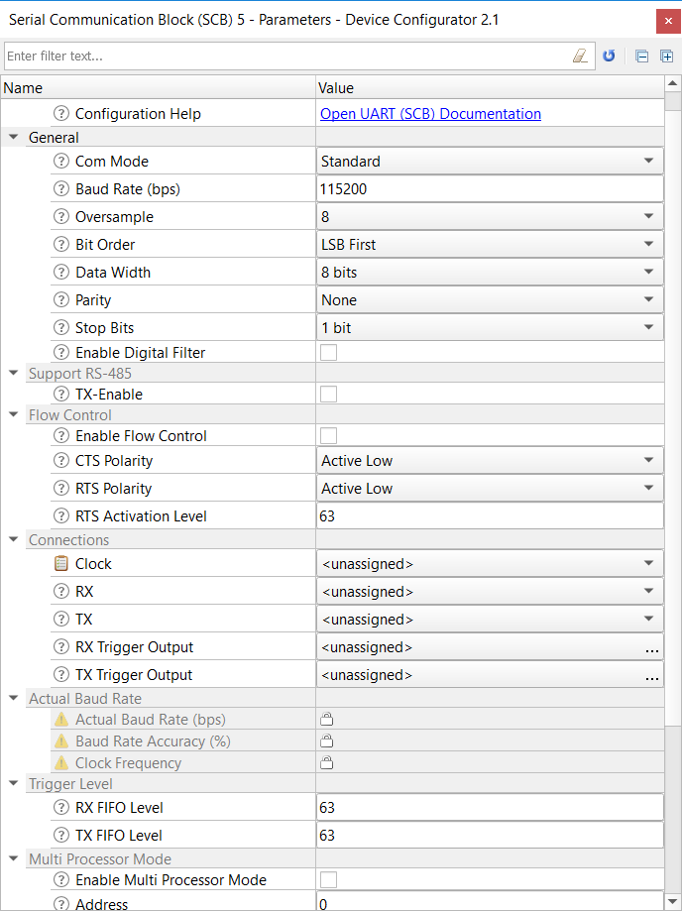
Serial Communication Block
Multi-functional, configurable digital communication block
Can be made to function as communication components:
I2C
SPI
UART
Standard SPI master and slave functionality with Motorola, Texas Instruments, and National Semiconductor protocols Standard
UART functionality
Standard I2C master and slave functionality
Trigger outputs for connection to DMA
Multiple interrupt sources to indicate status of FIFOs and transfers

Slide 33
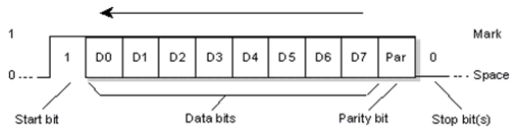
Serial Communication Block
UART
Universal asynchronous transmitter and receiver
Half duplex, full duplex,, only TX and only RX modes
Two wire – Transmit (TX) and Receive (RX)
No Clock line
Typically used baud rates – 9600 to 115200 bps
Additional pins – flow control functionality
Usually between two devices

Slide 34
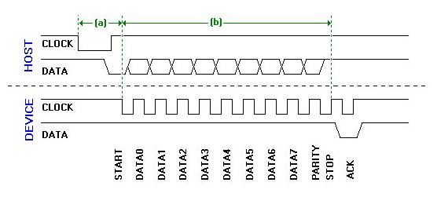
Serial Communication Block
UART
Universal asynchronous transmitter and receiver
Half duplex, full duplex,, only TX and only RX modes
Two wire – Transmit (TX) and Receive (RX)
No Clock line
Typically used baud rates – 9600 to 115200 bps
Additional pins – flow control functionality
Usually between two devices

Slide 35
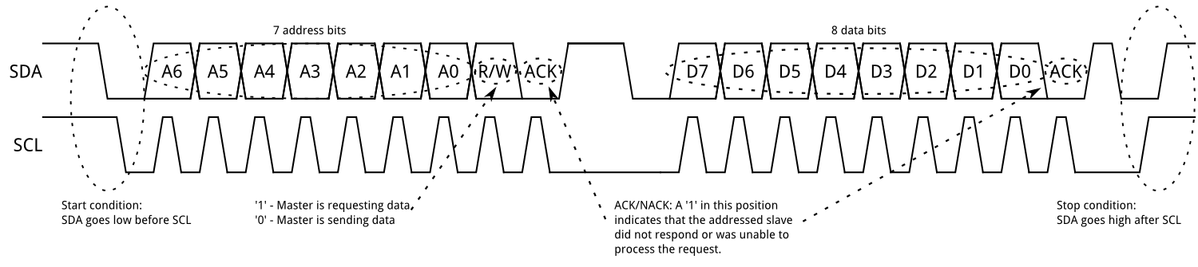
Serial Communication Block
UART
I2C
Universal asynchronous transmitter and receiver
Half duplex, full duplex,, only TX and only RX modes
Two wire – Transmit (TX) and Receive (RX)
No Clock line
Typically used baud rates – 9600 to 115200 bps
Additional pins – flow control functionality
Usually between two devices
Inter-integrated circuit (IIC / I²C)
Half duplex protocol
Two wire – Serial Data (SDA) and Serial Clock (SCL)
Typically used clock rates – 100 kHz to 400 kHz
A master can talk to 127 slaves

Slide 36
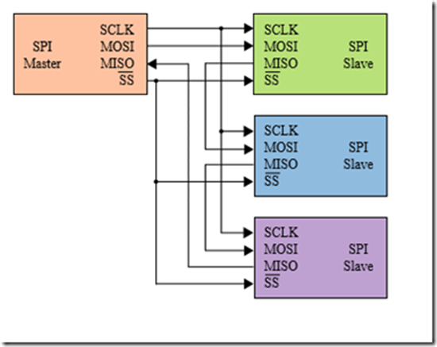
Serial Communication Block
UART
I2C
SPI
Universal asynchronous transmitter and receiver
Half duplex, full duplex,, only TX and only RX modes
Two wire – Transmit (TX) and Receive (RX)
No Clock line
Typically used baud rates – 9600 to 115200 bps
Additional pins – flow control functionality
Usually between two devices
Inter-integrated circuit (IIC / I²C)
Half duplex protocol
Two wire – Serial Data (SDA) and Serial Clock (SCL)
Data rates from 100 kbps to 1000kbps
A master can talk to 127 slaves
Serial peripheral interface
Full duplex protocol
Four wire –
Master Out Slave In (MOSI)
Master In Slave Out (MISO)
Serial clock (SCK)
Slave Select (SS)
Typically used data rates – 1 Mbps to 8 Mbps

Slide 37
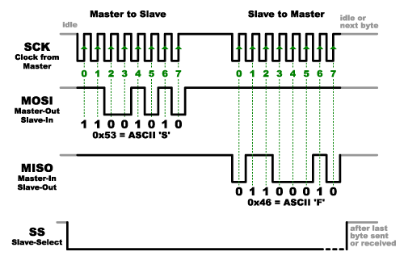
Serial Communication Block
UART
I2C
SPI
Universal asynchronous transmitter and receiver
Half duplex protocol, can TX and RX data but not at the same time
Two wire – Transmit (TX) and Receive (RX)
No Clock line
Typically used baud rates – 9600 to 115200 bps
Additional pins – flow control functionality
Usually between two devices
Inter-integrated circuit (IIC / I²C)
Half duplex protocol
Two wire – Serial Data (SDA) and Serial Clock (SCL)
Typically used clock rates – 100 kHz to 400 kHz
A master can talk to 127 slaves
Serial peripheral interface
Full duplex protocol
Four wire –
Master Out Slave In (MOSI)
Master In Slave Out (MISO)
Serial clock (SCK)
Slave Select (SS)
Typically used data rates – 1 Mbps to 8 Mbps

Slide 38
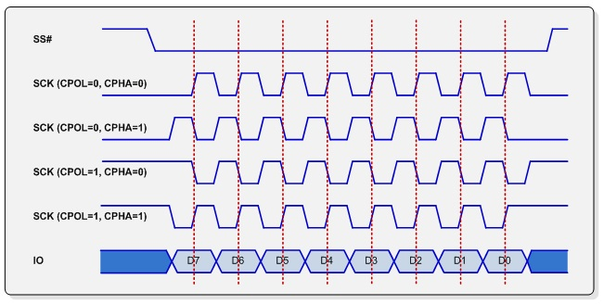
Serial Communication Block
UART
I2C
SPI
Universal asynchronous transmitter and receiver
Half duplex protocol, can TX and RX data but not at the same time
Two wire – Transmit (TX) and Receive (RX)
No Clock line
Typically used baud rates – 9600 to 115200 bps
Additional pins – flow control functionality
Usually between two devices
Inter-integrated circuit (IIC / I²C)
Half duplex protocol
Two wire – Serial Data (SDA) and Serial Clock (SCL)
Typically used clock rates – 100 kHz to 400 kHz
A master can talk to 127 slaves
Serial peripheral interface
Full duplex protocol
Four wire –
Master Out Slave In (MOSI)
Master In Slave Out (MISO)
Serial clock (SCK)
Slave Select (SS)
Typically used data rates – 1 Mbps to 8 Mbps

Slide 39
UART
Exercise 8:
Use the project from Exercise 6 (Generate PWM signal of 100 Hz frequency with 10% duty cycle)
Print the PWM parameters (duty cycle, compare value, period) on a PC terminal using UART
Control PWM duty cycle from the PC (increase or decrease by 10% upon two different keypresses)
Solution key: Use mtb_02_ex06_counter_dutycycle project for reference.
Useful APIs:
Retarget-IO Middleware – cy_retarget_io_init(CYBSP_DEBUG_UART_TX, CYBSP_DEBUG_UART_RX, 115200);
Then make use of standard IO library functions like printf, sprintf etc. to read or print something to the terminal.

Slide 40
I2C
Exercise 9:
Control PWM brightness by writing data from an I2C master (use KitProg3 as master; using Bridge Control panel (BCP) on PC)
Solution key: Refer mtb_02_ex07_i2c_brightness_control project for this solution.
Useful APIs:
/* Allocate and initialize a I2C resource and auto select a clock */
cyhal_i2c_init(&i2c_slave, CYBSP_I2C_SDA, CYBSP_I2C_SCL, NULL);
/* Configure the I2C resource to be slave */
cyhal_i2c_configure (&i2c_slave, &i2c_slave_cfg);
/* Configure I2C slave write buffer for I2C master to write into */
cyhal_i2c_slave_config_read_buff(&i2c_slave, i2c_write_buffer, SL_WR_BUFFER_SIZE);
/* Configure I2C slave read buffer for I2C master to read from */
cyhal_i2c_slave_config_write_buff(&i2c_slave, i2c_read_buffer, SL_RD_BUFFER_SIZE);

Slide 41
SPI
Exercise 10:
Setup PSoC as both an SPI master and slave. SPI master sends a command every second to a SPI slave to toggle the LED. Use HAL APIs.
Solution key: Refer mtb_02_ex08_spi_master project for this solution.
Useful APIs:
cyhal_spi_init() – Initializes the SPI block and configures it as slave or master.
cyhal_spi_set_frequency() – set the SPI baud rate
cyhal_spi_send() – Sends the command
cyhal_spi_recv() – Receives the command

Slide 42
Resources
ModusToolbox User Guide
Cypress Github Landing Page
PSoC6 Architecture TRM

Slide 43
Contact Information
https://community.cypress.com/welcome
Send your queries to ddka@cypress.com

